Slide 1
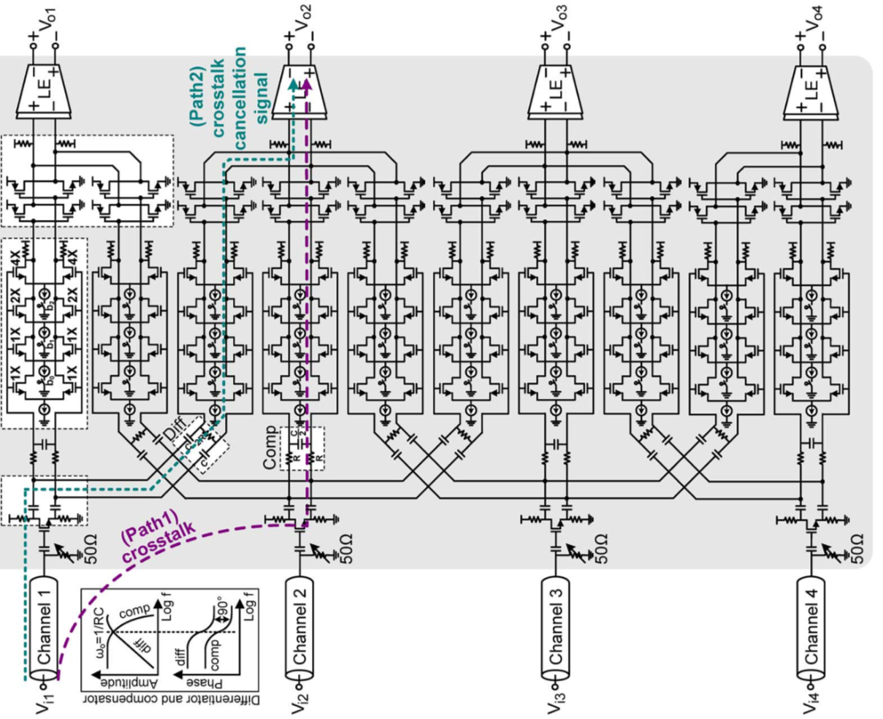
Equalizer Design
Linear
Equalizer
Adder
Variable
Gain Amplifier
Single to
Differential
Converter
[Oh, JSSC 2013]

Slide 2
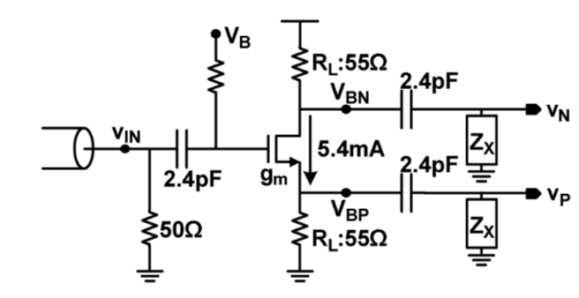
FinFET based Design: SDC
Parameters | Value
M:W | 512 x width/fin
M:L | 2 x L_{min}
R_{L} | 55 ohm
R_{B} | 10k ohm
R1 | 50 ohm
C₀ | 60f
R_{B}
C₀
R1
Parameters | Value
Width/fin | 27n
L_{min} | 7n

Slide 3
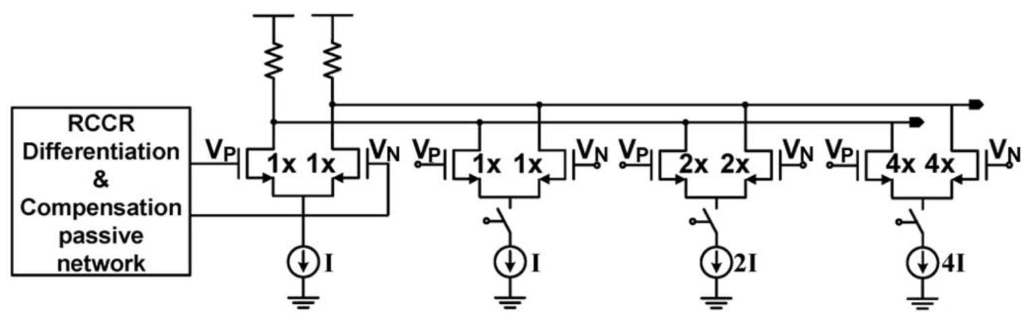
FinFET based Design: VGA
Parameters | Value
M_{DP}:W | 24,24,48,96 x width/fin
M_{CM}:W | 30,30,60,120 x width/fin
M_{DP}:L, M_{CM}:L | 2 x L_{min}
Parameters | Value
R_{L} | 400
C_{L} | 10f
* All current sources are connected in current mirror configuration.

Slide 4
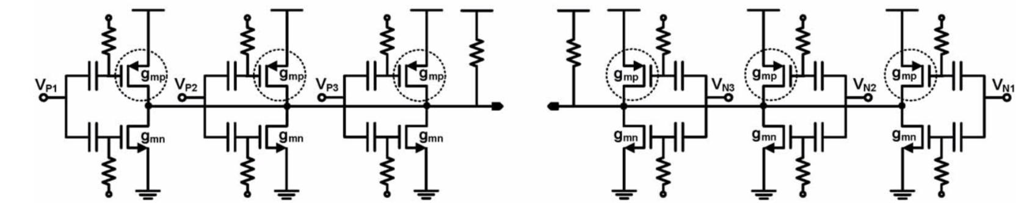
FinFET based Design: Adder
Parameters | Value | Count
M_{NMOS}:W | 20 x width/fin | 6
M_{PMOS}:W | 20 x width/fin | 6
M_{NMOS}:L, M_{PMOS}:L | 2 x L_{min}
Parameters | Value | Count
R_{L} | 550 | 2
C_{L} | 10f | 2
R_{B} (each) | 2.4k | 12
C_{B} (each) | 50f | 12
R_{B}
R_{L}
R_{L}
C_{B}
C_{B}
R_{B}

Slide 5
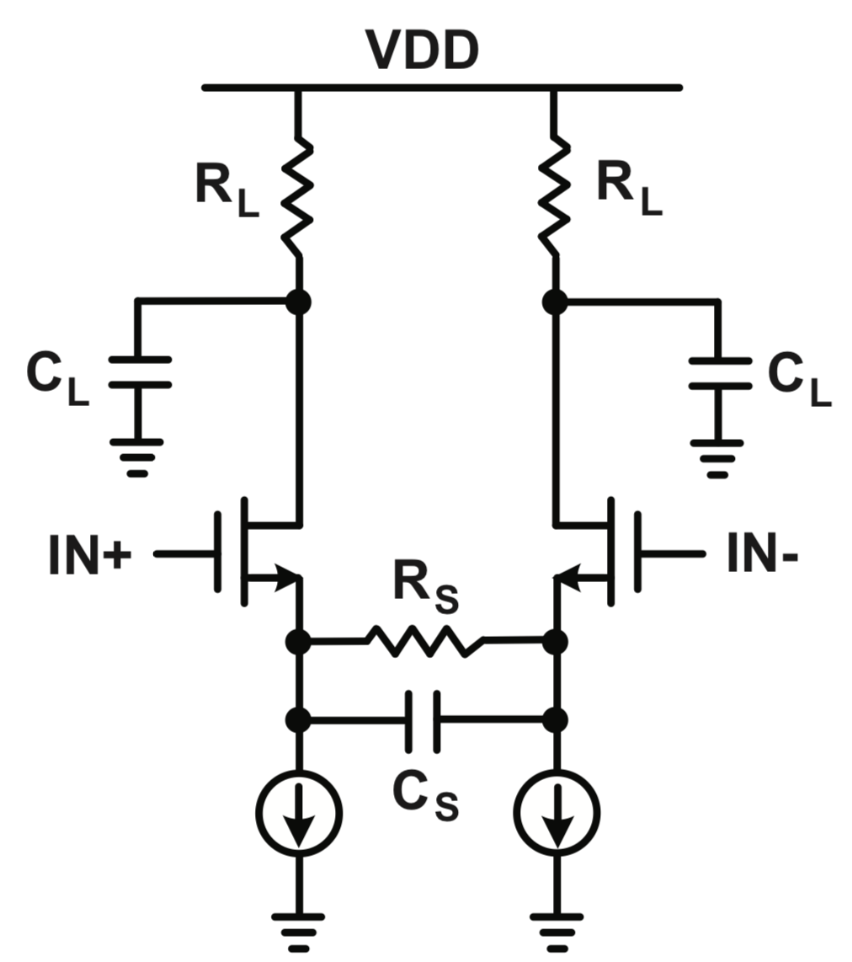
FinFET based Design: CTLE
Parameters | Value
M_{DP}:W | 144 x width/fin
M_{CM}:W | 120 x width/fin
M_{DP}:L, M_{CM}:L | 2 x L_{min}
R_{L} | 200
C_{L} | 10f
Parameters | Value | Comment
R_{s} | 250,500,750,1000,1250,1500,1750,2000 (Range: 250~2000 ohm) | A variable resistance. Gain varies with R_{s}. With the current range of R_{s}.
C_{s} | 20f, 40f, 60f, 80f, 100f, 120f, 140f (Range: 20f ~ 140f) | A variable capacitance. High cut-off frequency varies with C_{s}.

